Slide 1
Mastering System Design
Section 2: System Design Fundamentals
Networking & Communication

Slide 2
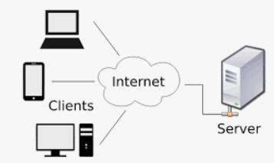
Why Networking Matters in System Design?
Every system relies on data exchange between components
Networking enables scalability, reliability, and performance
Key areas where networking plays a crucial role:
  Communication: Ensuring smooth data transfer between clients, servers, and databases
  Load Balancing: Distributing traﬃc eﬃciently to prevent overload on a single server
  Security: Protecting data from unauthorized access and cyber threats
  Eﬃciency: Optimizing network performance to reduce latency and improve user experience

Slide 3
How Networking Impacts Large-Scale Systems
Helps handle millions of users concurrently
Enables fast and eﬃcient data exchange
Reduces latency & improves system resilience
Essential for cloud computing & distributed systems

Slide 4
Agenda: Key Networking Concepts in System Design
Understanding IP Addresses
How DNS Works
Client-Server Model Explained
Forward Proxy vs. Reverse Proxy
Introduction to Load Balancing
What is an API Gateway?
Content Delivery Networks (CDN) in System Design

Slide 5
Wrap-Up & What’s Next
Networking is the foundation of system design
Next, we’ll deep dive into networking components
Coming up: IP Addressing & DNS

Slide 6
Understanding IP Addresses in System Design
Networking & Communication

Slide 7
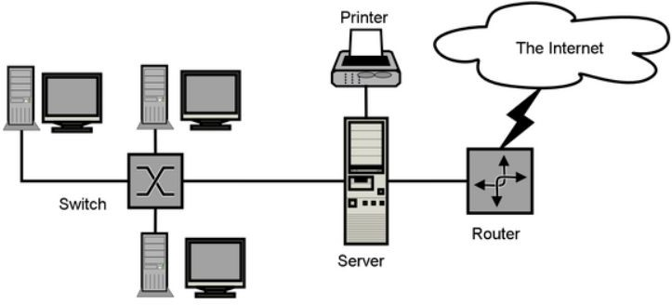
Introduction to IP Addresses
IP (Internet Protocol) addresses are unique numerical labels assigned to devices on a network.
They enable communication between diﬀerent machines, servers, and services across the internet.
Two primary versions:
  IPv4
  IPv6
Two primary categories:
  Public
  Private

Slide 8

What is IPv4?
IPv4 (Internet Protocol Version 4) is the most widely used addressing system.
32-bit address format (e.g., 192.168.1.1)
Total addresses available: ~4.3 billion
Uses: Traditional networking, web servers, and most current internet devices.
Challenges: Limited IPs, fragmentation, and security concerns.

Slide 9
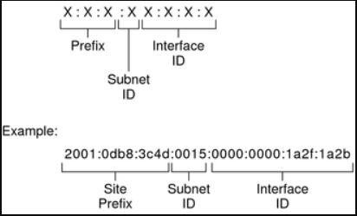
What is IPv6?
IPv6 (Internet Protocol Version 6) is the next-generation IP standard.
128-bit address format -
2001:0db8:85a3:0000:0000:8a2e:0370:7334
Total addresses available: 340 undecillion (virtually unlimited).
Designed for: IoT, mobile networks, and
future scalability.
Key beneﬁts: Larger address space, better security, and improved routing eﬃciency.

Slide 10
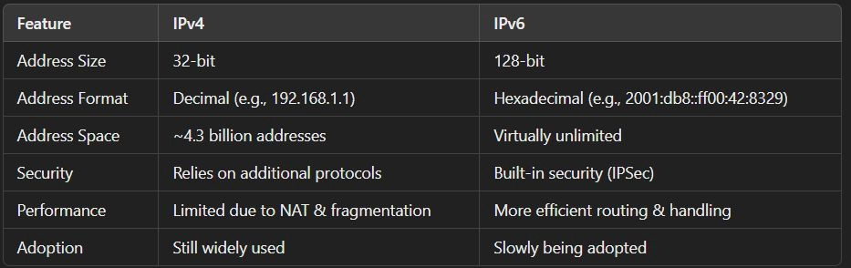
IPv4 vs. IPv6 – Key Differences

Slide 11
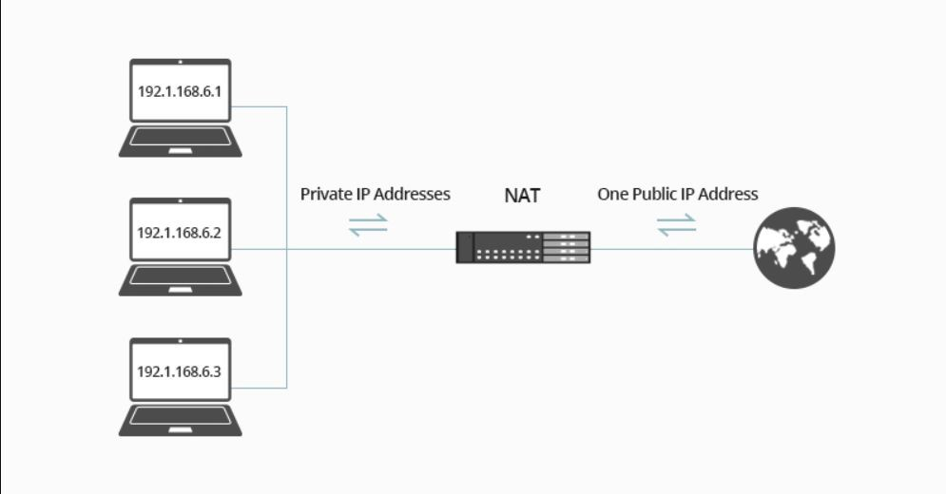
Private vs. Public IPs
Public IPs:
  Assigned by ISPs (Internet Service Providers).
  Used to communicate over the internet.
  Unique worldwide.
  Example: 192.203.23.45.
Private IPs:
  Used within local networks (LANs, enterprises, homes).
  Cannot be accessed directly from the
internet.
  examples:
    10.0.0.0 - 10.255.255.255
    172.16.0.0 - 172.31.255.255
    192.168.0.0 - 192.168.255.255

Slide 12
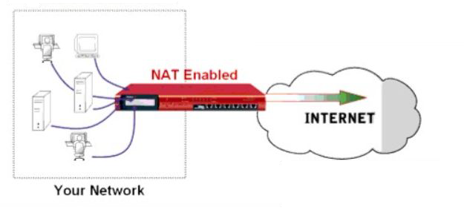
Why Do We Need Private IPs?
Conserves public IP addresses (IPv4 limitation).
Enhances security (private IPs are not routable over the internet).
Enables Network Address Translation (NAT) to allow multiple devices to share a single public IP.
Common in corporate networks, data centers, and cloud environments.

Slide 13
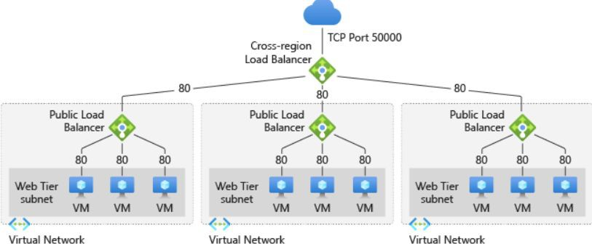
The Role of IPs in System Design
Scalability: Helps in designing distributed, multi-region, and cloud-based architectures.
Security: Enables ﬁrewall rules, VPNs, and private networking.
Load Balancing: Uses IP-based traﬃc distribution (e.g., Round-robin DNS, Anycast IPs).
Cloud Networking: Public, private, and hybrid cloud IP management (AWS, GCP, Azure).
Microservices & Containers: Use internal private IPs for communication.

Slide 14
Common System Design Interview Questions on IPs
How do IPv4 and IPv6 addresses diﬀer?
Why do we need private IPs in system design?
How does NAT help in addressing the IPv4 shortage?
Explain how a load balancer distributes traﬃc using IPs.
How does DNS resolve IP addresses in a large-scale system?

Slide 15
Summary & What’s Next
IPv4 and IPv6 are the two primary internet protocols.
Private vs. Public IPs help manage internal and external networking.
Networking & IPs are essential for system scalability, security, and performance.
Coming up next: How DNS works and its role in system design.

Slide 16
How DNS Works
Networking & Communication

Slide 17
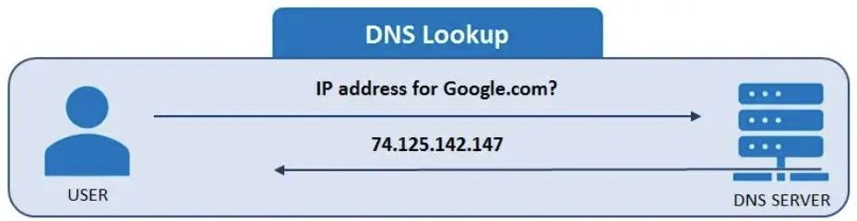
Introduction to DNS
What is DNS?
  The "phonebook of the internet."
  Translates human-readable domain names (e.g., google.com) into IP addresses.
Why is DNS important?
  Enables accessibility of websites.
  Supports distributed, scalable internet architecture.

Slide 18
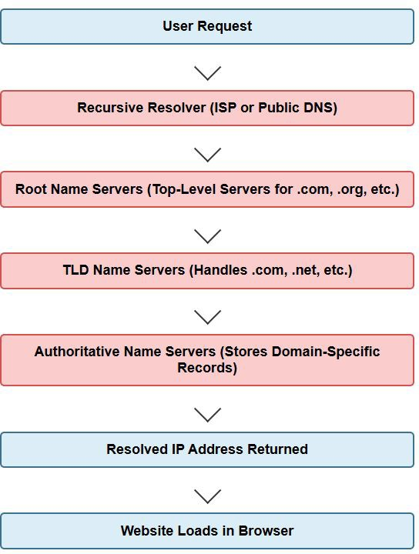
Types of DNS Servers
Root Name Servers: Top-level servers handling .com, .org, etc.
TLD Name Servers: Speciﬁc to domains like .com, .net.
Authoritative Name Servers: Store domain-speciﬁc records.
Recursive Resolvers: Handle queries on behalf of users, contacting multiple DNS servers if necessary.

Slide 19
DNS Caching and Performance Optimization
Why caching matters?
  Reduces latency.
  Reduces load on DNS servers.
Where caching occurs?
  Browser cache (stores previous lookups).
  OS cache (/etc/hosts, Windows DNS cache).
  Recursive Resolver cache (ISP level).
Time-To-Live (TTL): Determines how long a cached record is valid.

Slide 20
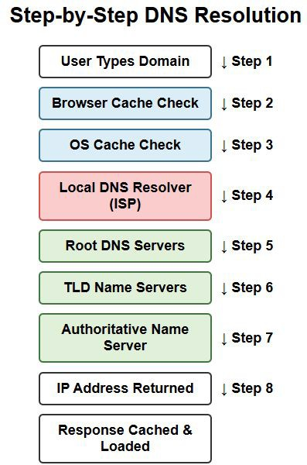
The Domain Name Resolution Process
Step-by-step breakdown of how DNS resolves a domain name:
  User types a domain name in the browser.
  Browser cache check (if the IP is already known).
  Operating System (OS) cache check.
  Query to the Local DNS Resolver (ISP or conﬁgured DNS server).
  If not found, query goes to Root DNS servers.
  TLD (Top-Level Domain) servers provide the Authoritative DNS server details.
  Authoritative DNS server returns the IP
address.
  Response is cached and returned to the user.

Slide 21
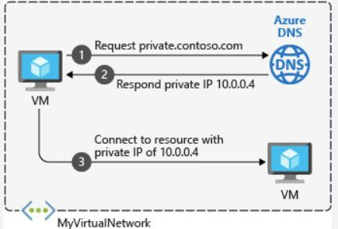
Importance of DNS in Large-Scale Systems
Ensuring High Availability
  Load balancing using DNS.
  Anycast DNS for faster global resolution.
DNS Failover Strategies
  Primary and secondary DNS servers.
Content Delivery Networks (CDNs) & DNS
  How DNS directs users to the nearest CDN node for fast loading.
DNS Security Risks
  DNS poisoning, cache poisoning, and DDoS attacks.

Slide 22
Interview Questions Related to DNS
Explain the DNS resolution process step by step.
What is the diﬀerence between authoritative and recursive DNS servers?
How does DNS caching improve performance? Where does it occur?
What is TTL in DNS, and why is it important?
How does DNS-based load balancing work in large-scale systems?
What are common DNS-related security threats, and how can they be mitigated?

Slide 23
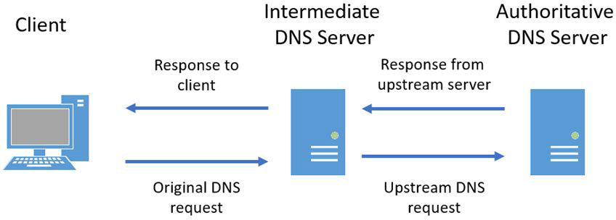
Summary & Takeaways
DNS is critical for internet functionality.
Caching improves eﬃciency and reduces latency.
DNS load balancing & failover are essential for large-scale systems.
Security threats exist, but best practices help mitigate them.
What's Next
  Client-Server Model Explained

Slide 24
Client-Server Model Explained
Networking & Communication

Slide 25
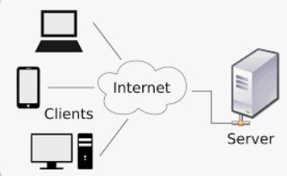
What is the Client-Server Model?
A computing model where clients request services and servers provide them.
Foundation of modern web, database, and application architectures.
Why is it important?
  Enables eﬃcient resource management.
  Used in web browsing, email, APIs, databases, and cloud services.
Real-world examples:
  Browsing a website (Browser = Client, Web Server = Server).
  Sending an email (Email App = Client, Mail Server = Server).

Slide 26
Key Components of the Client-Server Model
Client:
  The user-facing application that sends requests.
  Examples: Web browser, mobile app, API consumer.
Server:
  A system that processes requests and returns responses.
  Examples: Web server, database server, mail server.
Network:
  The medium that facilitates communication between clients and servers.
  Examples: Internet, LAN, Wi-Fi, 5G.

Slide 27
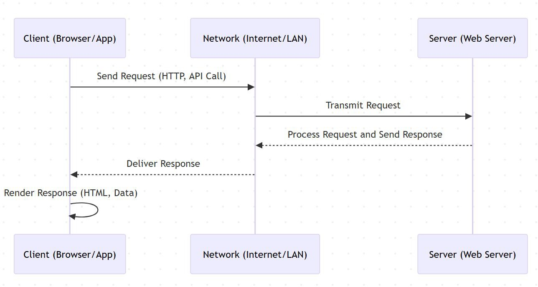
How Clients and Servers Communicate
Basic Steps:
  Client sends a request (HTTP, SQL query, etc.).
  Request is transmitted over the network.
  Server receives and processes the request.
  Server sends a response.
  Client receives and processes the response.
Types of Communication:
  Request/Response Model (e.g., HTTP, REST APIs)
  Persistent Connections (e.g., WebSockets, FTP sessions)

Slide 28
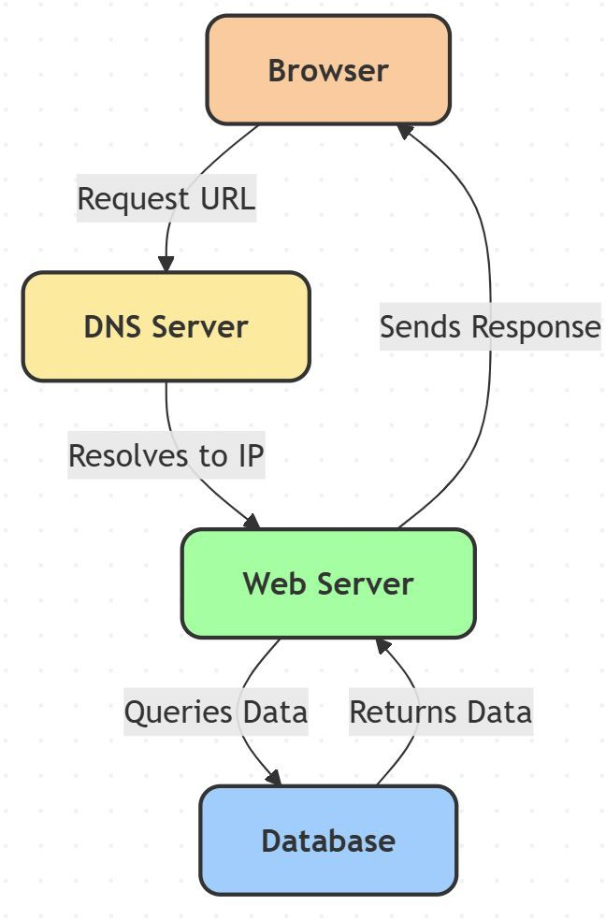
The Request-Response Cycle (HTTP Example)
Browser requests https://example.com.
DNS resolves domain to IP address.
Browser sends an HTTP GET request to the web server.
Web server processes request, fetches HTML, queries the database if needed.
Server sends an HTTP response with a status code (200 OK) and the webpage content.
Browser renders the webpage.

Slide 29
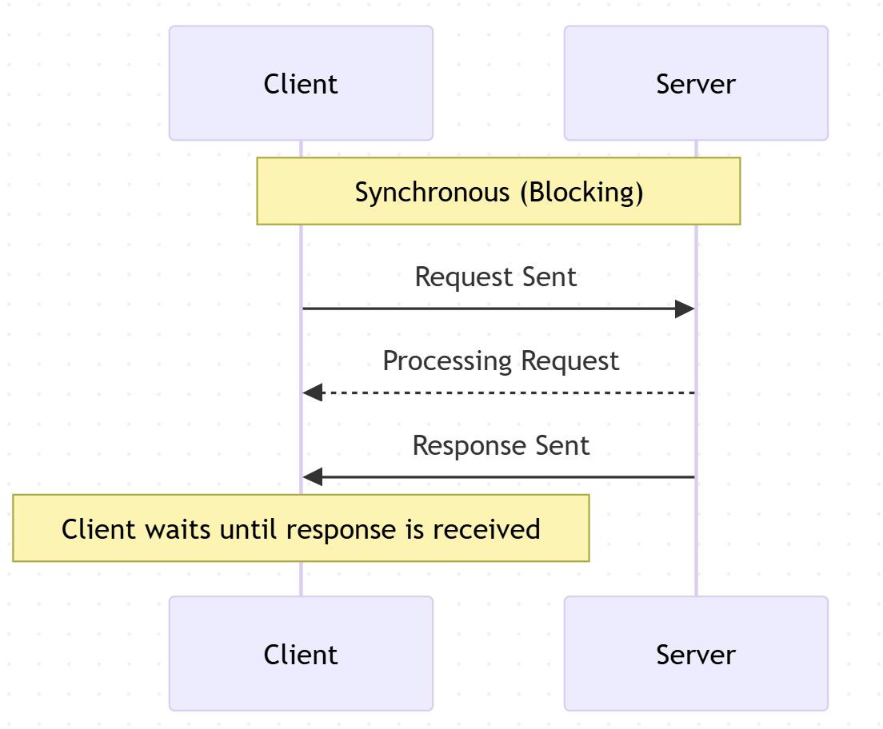
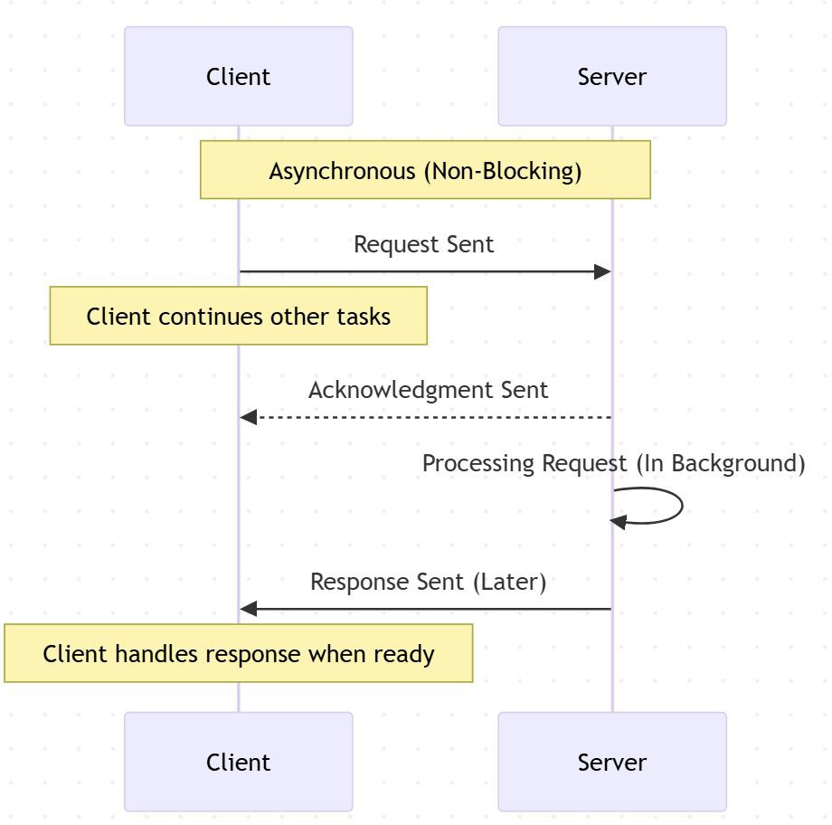
Synchronous vs Asynchronous Communication
Synchronous Communication:
  Client waits for a response before proceeding.
  Example: A user submits a form and
waits for a conﬁrmation message.
  Used in REST APIs, traditional web apps.
Asynchronous Communication:
  Client doesn’t wait for a response and can perform other tasks.
  Example: WebSockets for real-time
chat, AJAX for background requests.
  Used in messaging apps, live updates, IoT applications.

Slide 30
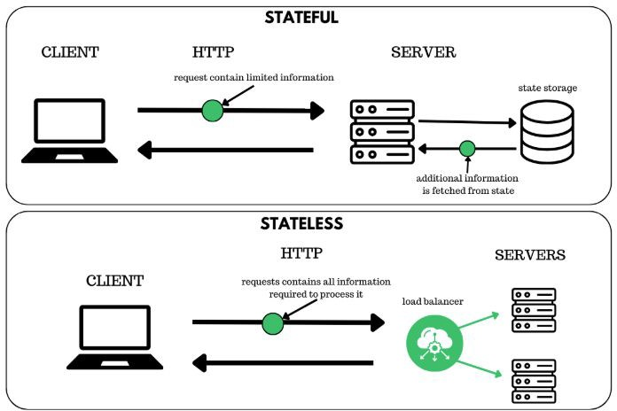
Stateless vs Stateful Servers
Stateless Servers:
  No memory of past interactions; each request is independent.
  Example: REST APIs, HTTP servers.
  Beneﬁts: Scalability, easy caching, load balancing.
Stateful Servers:
  Maintain session information across requests.
  Example: WebSockets, multiplayer games, banking applications.
  Beneﬁts: Personalization, seamless user experiences.

Slide 31
Real-World Examples
Web Applications:
  Browsing a website (Client = Browser, Server = Web Server).
APIs & Microservices:
  Mobile apps calling backend APIs (REST, GraphQL).
Databases:
  A client querying a database (SQL Client → Database Server).
Messaging Systems:
  WhatsApp, Slack using WebSockets for real-time communication.

Slide 32
Interview Questions on the Client-Server Model
Fundamental Questions:
  What is the client-server model, and how does it work?
  How does a client communicate with a server?
  What are some real-world examples of the client-server model?
  What is the diﬀerence between a client and a server?
Request-Response Cycle Questions:
  Explain the HTTP request-response cycle with an example.
  What are the key diﬀerences between synchronous and asynchronous communication?
  How does a browser load a webpage? Walk me through the steps.
Architecture and Design Questions:
  What is the diﬀerence between stateless and stateful servers?
  How does caching improve performance in a client-server model?
  How do load balancers work in a client-server architecture?
Advanced Questions:
  What are some security challenges in the client-server model?
  How does WebSockets diﬀer from traditional request-response communication?
  What are some limitations of the client-server model? How can they be addressed?
  How would you design a scalable client-server system for a high-traﬃc application?

Slide 33
Wrap up and what’s next….
Key Takeaways:
  The client-server model underpins most modern computing.
  Diﬀerent communication patterns (sync vs async, stateless vs stateful) optimize performance for diﬀerent use cases.
  Understanding this model helps in system design and scalability planning.
Next Steps:
  Forward Proxy vs. Reverse Proxy

Slide 34
Forward Proxy vs. Reverse Proxy
Networking & Communication

Slide 35
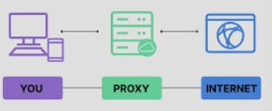
What is a Proxy?
A proxy is an intermediary server between a client and another server.
Proxies help with security, caching, traﬃc control, and anonymity.
Two main types: Forward Proxy & Reverse Proxy.

Slide 36
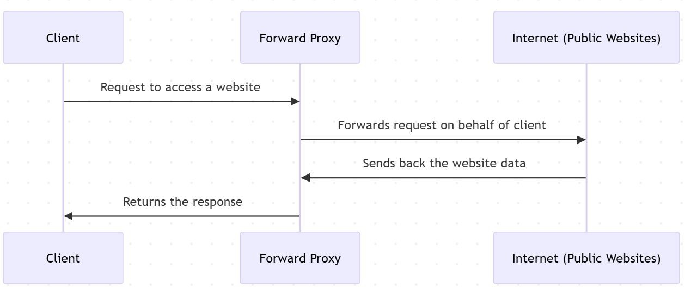
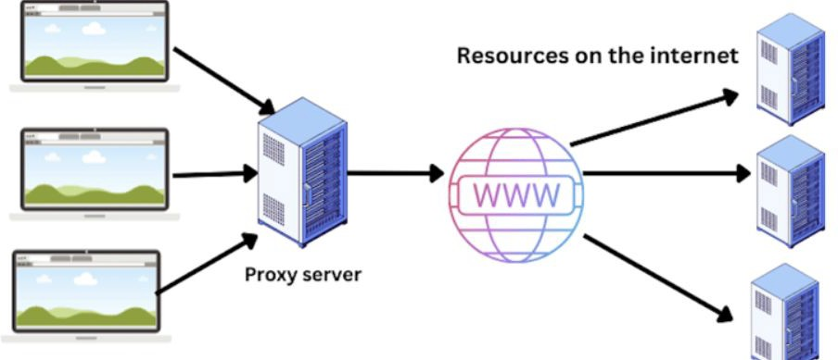
What is a Forward Proxy?
Sits between a client and the internet (used by clients).
Clients connect to the forward
proxy instead of directly accessing websites.
Can ﬁlter content, provide anonymity, and cache requests.
Common use cases:
  Bypassing geo-restrictions
  Anonymous browsing (VPNs, TOR)
  Caching web pages for faster access

Slide 37
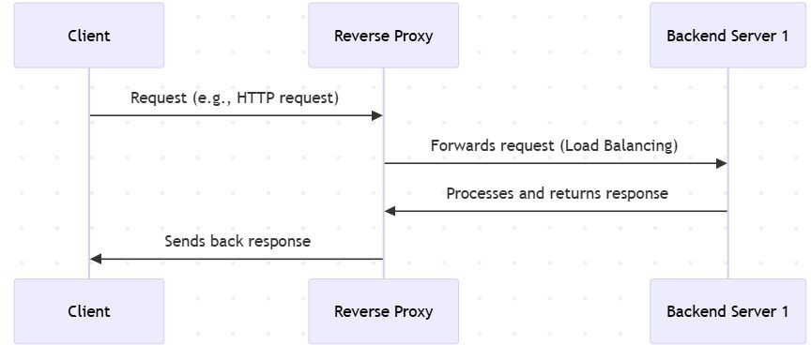
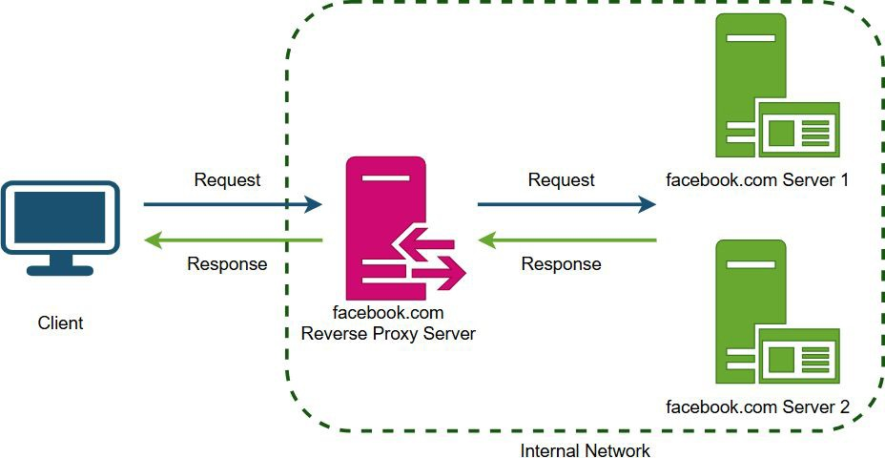
What is a Reverse Proxy?
Sits between users and backend servers (used by servers).
Clients don’t directly communicate with backend servers—requests go through the reverse proxy.
Used for load balancing, caching, security, and SSL termination.
Common use cases:
  Load balancing across multiple servers
  Caching content to improve speed
  DDoS protection & security

Slide 38
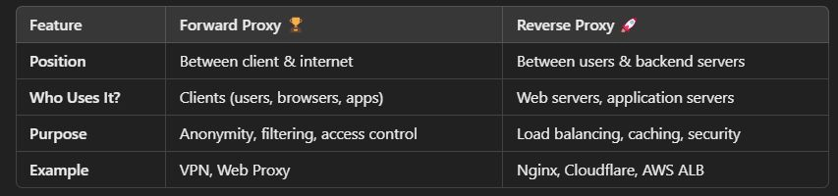
Key Differences - Forward vs. Reverse Proxy

Slide 39
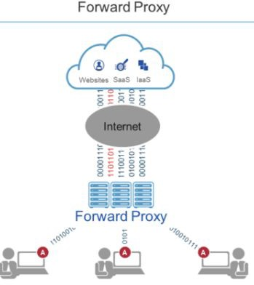
Use Cases for Forward Proxy
Privacy & Anonymity (Hides user IP)
Content Filtering (Restrict certain websites)
Bypass Geo-restrictions (Access region-blocked content)
Caching (Reduce redundant requests, speed up browsing)

Slide 40
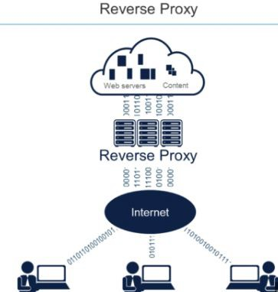
Use Cases for Reverse Proxy
Load Balancing (Distribute traﬃc to multiple servers)
Security & DDoS Protection (Hide backend servers, block attacks)
SSL Termination (Oﬄoad SSL processing to proxy)
Caching & Compression (Reduce load on backend servers)

Slide 41
Interview Questions on Forward Proxy vs. Reverse Proxy
Basic Concepts
  What is a proxy server, and why is it used?
  Explain the key diﬀerences between a forward proxy and a reverse proxy.
Technical Deep Dive
  How does a forward proxy improve security and privacy?
  How does a reverse proxy help in load balancing and caching?
  What are some real-world examples of forward and reverse proxies?
Implementation & Use Cases
  When should you use a forward proxy vs. a reverse proxy in system architecture?
  What are some common tools and technologies used for each type of proxy?
  How does a reverse proxy protect backend servers from DDoS attacks?
Advanced Topics
  How does SSL termination work in a reverse proxy?
  What are the advantages of using Cloudﬂare, Nginx, or HAProxy as a reverse proxy?
  How does a transparent proxy diﬀer from a forward or reverse proxy?

Slide 42
Wrap-Up & What’s Next?
Key Takeaways:
  A forward proxy helps clients interact with the internet securely.
  A reverse proxy protects and optimizes backend servers.
  Understanding proxy usage helps in designing scalable & secure architectures.
Next Topic:
  Load Balancers

Slide 43
Introduction to Load Balancing
Networking & Communication

Slide 44
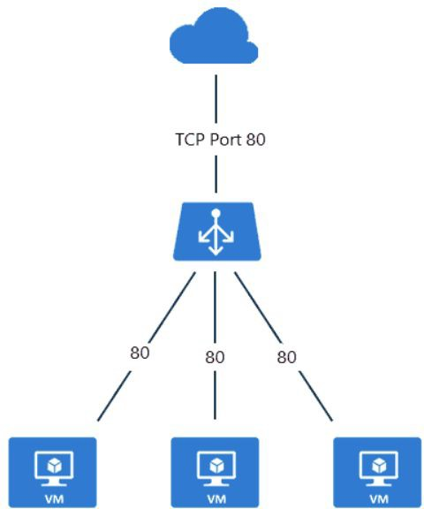
Why Load Balancing is Needed
High Availability: Ensures system uptime even under high traﬃc.
Traﬃc Distribution: Spreads requests evenly across servers.
Prevents Overload: Avoids overburdening a single server.
Improves Performance: Reduces latency and enhances response times.
Handles Failures Gracefully: Redirects traﬃc in case of server failure.
Supports Scalability: Helps scale systems eﬃciently.
Example: A high-traﬃc e-commerce site uses load balancing to handle peak-hour requests.

Slide 45
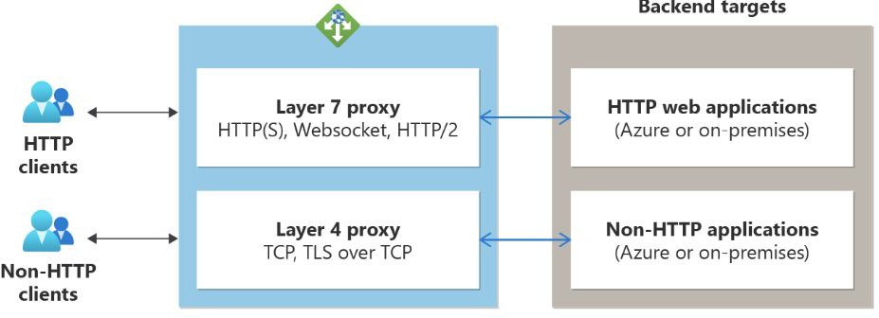
Types of Load Balancers
Based on Layer
  Layer 4 (Transport Layer): Operates at TCP/UDP level, distributing requests based on network-level data.
  Layer 7 (Application Layer): Operates at HTTP/HTTPS level, making routing decisions
based on request content.
Based on Deployment
  Hardware Load Balancers: Specialized devices (e.g., F5, Citrix NetScaler).
  Software Load Balancers: Nginx, HAProxy, Envoy.
  Cloud-based Load Balancers: AWS Elastic Load Balancer (ELB), Google Cloud Load Balancing.

Slide 46
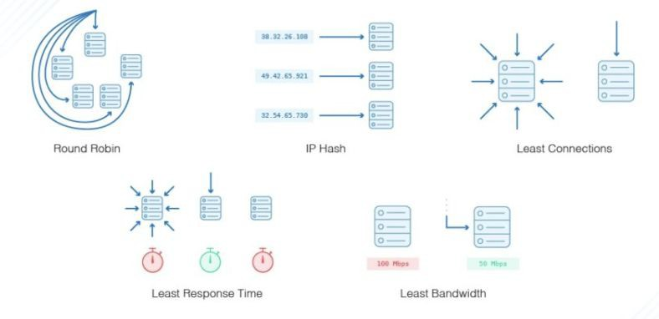
Load Balancing Strategies
Static Load Balancing
  Round Robin: Distributes requests sequentially to each server.
  Least Connections: Directs traﬃc to the
server with the fewest connections.
  IP Hashing: Routes requests based on client IP.
Dynamic Load Balancing
  Least Response Time: Sends requests to the server with the fastest response.
  Adaptive Load Balancing: Uses real-time
monitoring to make decisions.
  Weighted Load Balancing: Assigns diﬀerent weights to servers based on capacity.

Slide 47
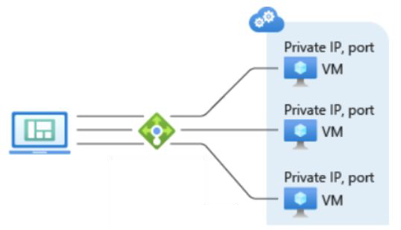
Load Balancer in Action
Example Scenario:
  A web application with multiple servers.
  Users send requests, and the load balancer distributes them eﬃciently.

Slide 48
Choosing the Right Load Balancer
Layer 4 vs. Layer 7: When to use each type.
Scalability Needs: Matching the right load balancer to traﬃc volume.
Security Concerns: SSL termination and DDoS protection.
Use Cases:
  Nginx/HAProxy for web applications.
  AWS ELB for cloud-native applications.
  Hardware Load Balancers for enterprise data centers.

Slide 49
Interview Questions on Load Balancing
Fundamentals
  What is load balancing, and why is it important?
  Explain the diﬀerence between Layer 4 and Layer 7 load balancing.
  How does a load balancer handle high availability and failover?
Strategies & Use Cases
  Compare Round Robin and Least Connections strategies.
  What are the advantages of Weighted Load Balancing?
  When would you use a software load balancer over a hardware one?
Real-World Scenarios
  How would you design a scalable load balancing solution for a large e-commerce site?
  What factors should be considered when choosing a load balancing strategy?
  How does a load balancer improve security?

Slide 50
Summary & Key Takeaways
Load balancing enhances scalability, reliability, and performance.
Diﬀerent types exist based on layers and deployment models.
Choosing the right strategy depends on traﬃc patterns and system needs.
Essential for highly available and resilient architectures.
What’s next:
  API Gateway

Slide 51
What is an API Gateway?
Networking & Communication

Slide 52
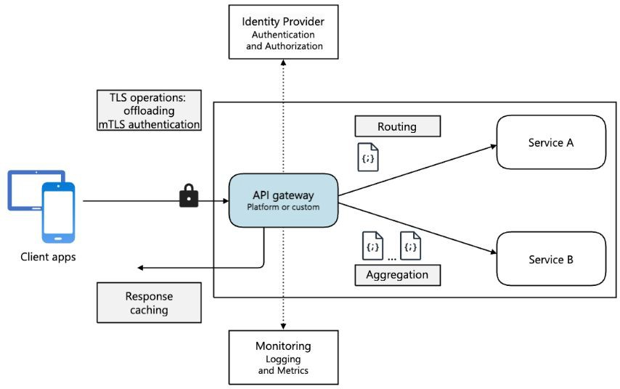
Introduction to API Gateways
In modern system architecture, APIs connect clients (web, mobile,
third-party apps) to backend services.
Directly exposing backend services can lead to performance, security, and management challenges.
API Gateway is a centralized entry point for all API requests, handling authentication, routing, caching, and security.

Slide 53
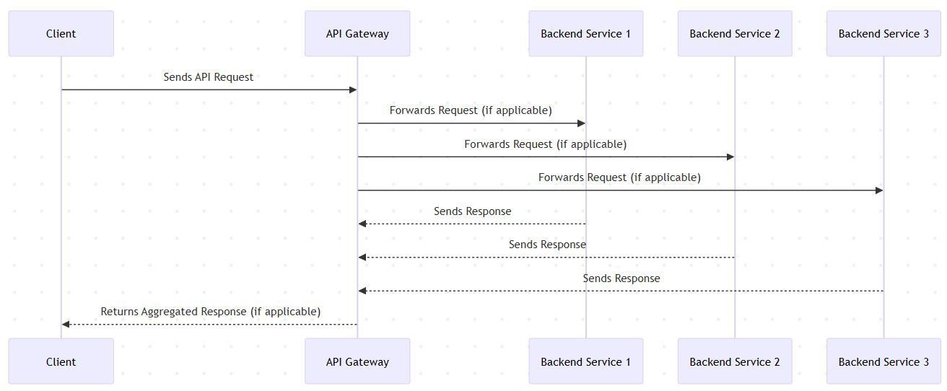
How API Gateways Work?
API Gateway acts as a reverse proxy between clients and backend services.
It receives API requests, processes them, and forwards them to the correct service.
Key functions include request transformation, authentication, rate limiting, and response handling.

Slide 54
Beneﬁts of Using an API Gateway
Security: Protects backend services from direct exposure.
Rate Limiting: Prevents abuse &
DDoS attacks.
Load Balancing: Distributes traﬃc eﬃciently.
Caching: Speeds up response times.
Request Transformation: Converts request formats, protocols, and headers.
Logging & Monitoring: Tracks API
performance and security events.

Slide 55
Security Features in API Gateways
Authentication & Authorization: Supports OAuth, JWT, API keys.
DDoS Protection: Blocks excessive requests from malicious sources.
Bot Protection: Uses rate limiting & CAPTCHA to ﬁlter out bot traﬃc.
TLS Termination: Handles SSL encryption to secure communication.

Slide 56
Rate Limiting & Throttling
Rate Limiting: Restricts the number of API calls per user/IP per second/minute.
Throttling: Controls traﬃc during peak loads to avoid system crashes.
Helps prevent abuse, protects backend services, and ensures fair usage.

Slide 57
Caching for Performance Optimization
Why Caching?: Speeds up API responses by storing frequently accessed data.
Types of Caching:
  In-memory caching (e.g., Redis)
  Response caching (storing API responses for quick reuse)
  Edge caching (CDN integration for global performance boost)

Slide 58
API Composition & Aggregation
API Gateways can combine multiple API calls into a single request.
Useful for microservices architecture where one client request may need data from multiple services.
Example:
  Instead of calling /user, /orders, and /cart separately,
  API Gateway calls all 3 services internally and returns a single response.

Slide 59
Logging & Monitoring with API Gateways
Helps track API performance, errors, and security threats.
Logs can be used for debugging, auditing, and analytics.
Supports integrations with tools like Prometheus, Grafana, and ELK Stack.

Slide 60
Popular API Gateway Implementations
Open-source solutions:
  Kong
  NGINX
  Traeﬁk
Cloud-based solutions:
  AWS API Gateway
  Google Apigee
  Azure API Management

Slide 61
When to Use an API Gateway?
Best suited for:
  Microservices architectures.
  Multi-client APIs (Web, Mobile, IoT).
  APIs requiring security, rate limiting, and monitoring.
Avoid if:
  Simple monolithic apps with minimal API exposure.
  Low-traﬃc, internal-only services.

Slide 62
API Gateway - Interview Questions
Basic Questions:
  What is an API Gateway, and why is it used?
  How does an API Gateway diﬀer from a Load Balancer?
  What are the key beneﬁts of using an API Gateway?
Technical Questions:
  How does an API Gateway handle authentication and authorization?
  Explain rate limiting and throttling in API Gateways.
  What caching strategies can be implemented in an API Gateway?
  How does an API Gateway improve security against DDoS attacks?
Scenario-Based Questions:
  When should you use an API Gateway in a microservices architecture?
  How would you design an API Gateway for a large-scale system with millions of users?
  What challenges might arise when implementing an API Gateway, and how would you address them?

Slide 63
Conclusion & Key Takeaways
API Gateway is a centralized entry point for managing API traﬃc.
Provides security, rate limiting, caching, and logging.
Useful for microservices & high-traﬃc applications.
Choosing the right API Gateway depends on use case & scale.
Whats next:
  Content Delivery Networks

Slide 64
Content Delivery Networks (CDN) in System Design
Networking & Communication

Slide 65
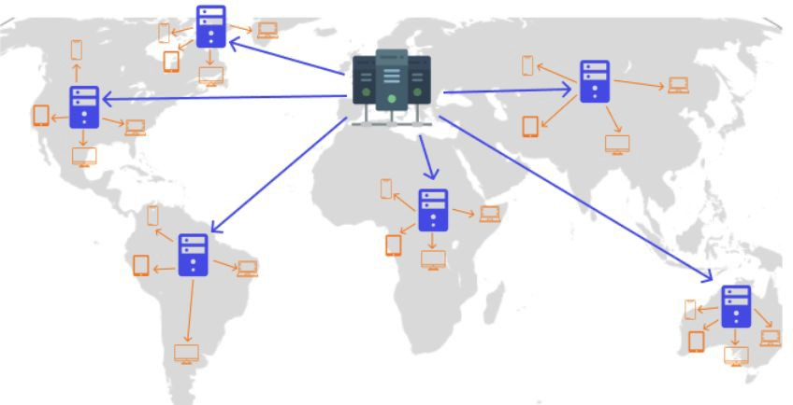
Introduction to CDNs
Deﬁnition: A CDN is a globally distributed network of servers that work together to deliver content eﬃciently.
Why CDNs exist:
  Reduces latency
  Enhances content availability
  Improves load handling
  Security

Slide 66
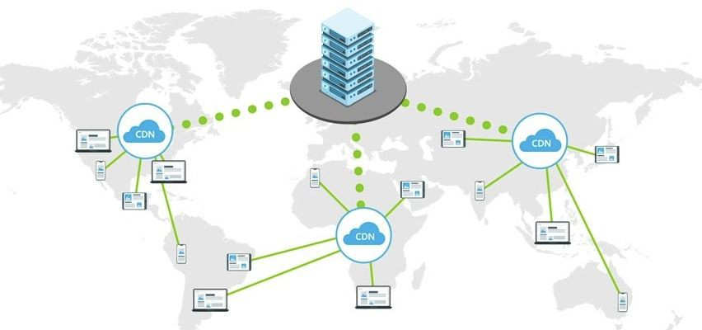
Why are CDNs needed?
The problem without CDNs:
High latency due to geographic distance
Overloaded origin servers
Bandwidth constraints & slow load times

Slide 67
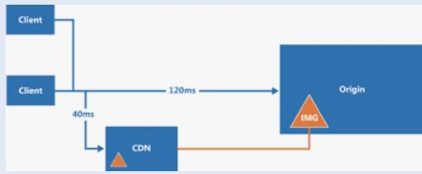
CDN Architecture Overview
Components of a CDN:
  Origin servers: Store the original content
  Edge servers (PoPs): Store cached content closer to users
  Request routing system: Directs users to the nearest PoP

Slide 68
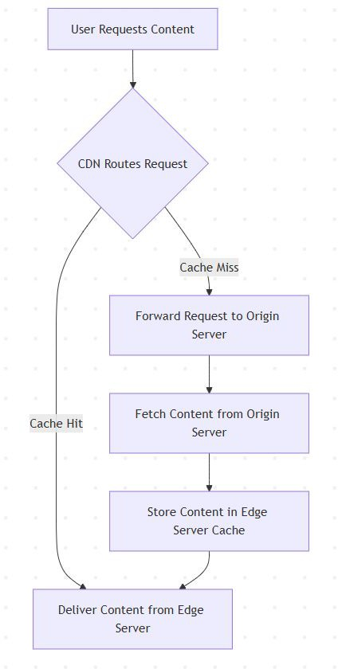
How a CDN Works and Handles a User Request
User requests content (e.g., website, video, API data).
CDN directs the request to the nearest edge server based on geographic location, network latency, and server load.
Cache Hit: If the content is available on the edge server, it is delivered instantly.
Cache Miss: If the content is not cached, the request is forwarded to the origin server, fetched, and stored at the edge server for future use.

Slide 69
Key CDN Features/Beneﬁts of CDN Working Mechanism
Caching & Replication(Reduced Latency): Frequently accessed content is stored at edge locations to minimize origin server load.
Load Balancing and request routing:(Improved Availability) Traﬃc is distributed across multiple PoPs to ensure reliability and prevent overload. CDN uses Geo-based, latency-based, and load-aware routing to optimize speed.
Compression & Optimization(Lower Bandwidth Costs): Techniques like Gzip, Brotli, and image optimization reduce ﬁle sizes for faster delivery.
Security Features(Better Security): DDoS Protection, SSL/TLS

Slide 70
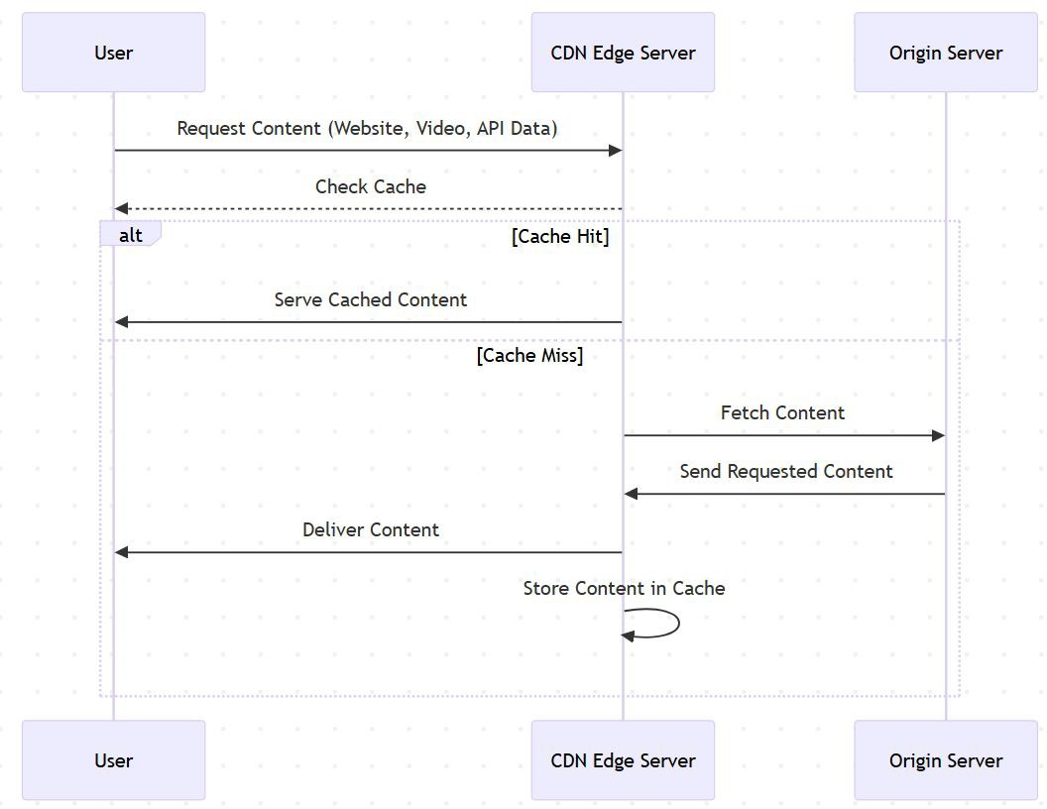
Content Caching and Replication
How CDNs cache content:
  Frequently accessed content is stored at the edge servers
  Cache expiration and TTL (Time-To-Live) settings control freshness
  Cache invalidation strategies (manual purge, stale-while-revalidate)

Slide 71
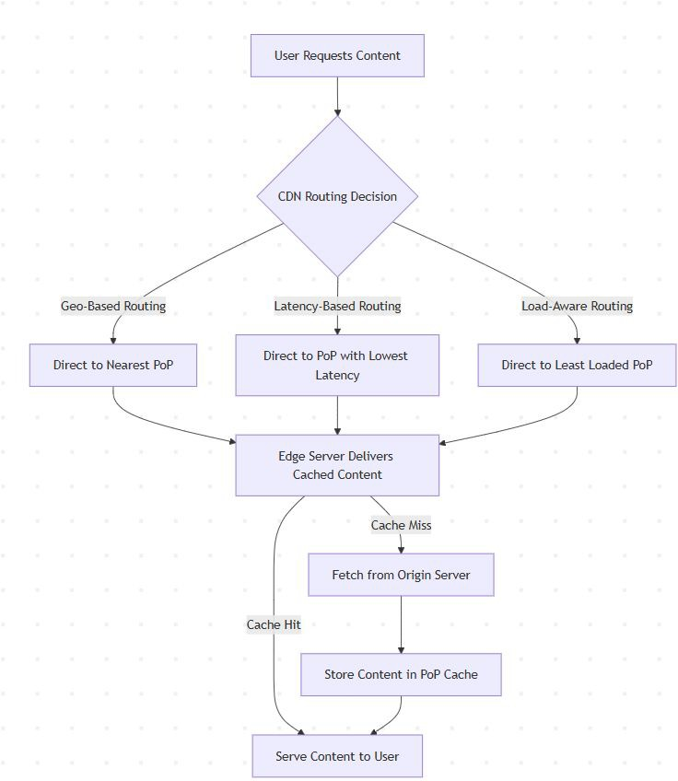
Load Balancing/Failover Handling and Request Routing
Load balancing across multiple PoPs
Failover strategies:
  Rerouting to another PoP
  Dynamic origin selection
Request routing strategies:
  Geo-based routing: Directs users to the nearest PoP
  Latency-based routing: Chooses the PoP with the lowest latency
  Load-aware routing: Balances traﬃc across PoPs

Slide 72
Compression & Miniﬁcation
Techniques used:
  Gzip & Brotli compression
  Image optimization (WebP, AVIF)
  Minifying CSS/JS to reduce ﬁle sizes

Slide 73
Security Features
DDoS mitigation:
  Rate limiting
  Traﬃc ﬁltering
SSL/TLS Oﬄoading: Encrypts traﬃc for security

Slide 74
Use Cases of CDNs
Static vs. Dynamic Content Delivery
  Static content: Images, videos, HTML ﬁles.
  Dynamic content: API responses, personalized pages.
API Acceleration & Edge Computing(CDNs for APIs):
  Reduce API response times.
  Edge caching for frequently accessed endpoints

Slide 75
Basics of CDN
  What is a CDN, and how does it work?
  Why do we need CDNs in system design?
  What are the key beneﬁts of using a CDN?
CDN Architecture & Components
  Explain the diﬀerence between an origin server and an edge server in a CDN.
  What is a PoP (Point of Presence) in a CDN?
  How does request routing work in a CDN?
Caching Strategies & Content Delivery
  What is a cache hit vs. cache miss, and how does a CDN handle them?
  Explain cache expiration and TTL (Time-To-Live) in a CDN.
  What are cache invalidation strategies, and why are they important?
  How does a CDN handle dynamic content caching?
Load Balancing & Failover Handling
  How do CDNs use load balancing to improve reliability?
  Explain diﬀerent request routing strategies (Geo-based, Latency-based, Load-aware).
  What happens if a CDN PoP fails? How does failover handling work?
CDN Optimization Techniques
  What compression and miniﬁcation techniques do CDNs use?
  How does a CDN optimize image and video delivery?
  How does API acceleration work in a CDN?
CDN Security & Challenges
  How does a CDN protect against DDoS attacks?
  What is SSL/TLS oﬄoading, and why is it useful?
  What are some challenges in CDN implementation, and how can they be mitigated?
Advanced CDN Topics
  How does a multi-CDN architecture work?
  What is edge computing, and how does it relate to CDNs?
  How would you design a CDN for a large-scale video streaming platform?
  How do CDNs help in real-time applications like online gaming or stock trading?

Slide 76
Wrap-Up & Key Takeaways
CDNs improve performance by caching and distributing content globally.
They reduce latency, improve load times, and lower bandwidth costs.
CDNs enhance security with DDoS protection, SSL/TLS encryption, and WAFs.
Use cases include static content delivery, API acceleration, and edge computing.
Next Topic:
  Networking Fundamentals Summary & Best Practices

Slide 77
Summary of Covered Topics - Networking & Communication
Introduction to Networking in System Design – Why networking is crucial in distributed systems.
Understanding IP Addresses – Diﬀerences between IPv4 & IPv6, public vs. private IPs.
How DNS Works – Domain Name Resolution, caching, and its role in large-scale systems.
Client-Server Model Explained – How clients and servers interact using request-response cycles.
Forward Proxy vs. Reverse Proxy – Their diﬀerences, use cases, and impact on system design.
Introduction to Load Balancing – Why it's needed, types of load balancers, and balancing strategies.
What is an API Gateway? – Managing API traﬃc, enforcing security, and enabling eﬃcient routing.
Content Delivery Networks (CDN) in System Design – How CDNs improve performance and reduce latency.
Whats Next
  Protocols

